Slide 1


Slide 2

Activity ideas
Start here if you are really stuck for ideas or if you want a safe and easy to resource activity which still allows children to decide for themselves what to investigate.
You could also have a look at one of our Science Oxford Challenges to get you started too: scienceoxford.com/resources/science-oxford-challenges

Slide 3
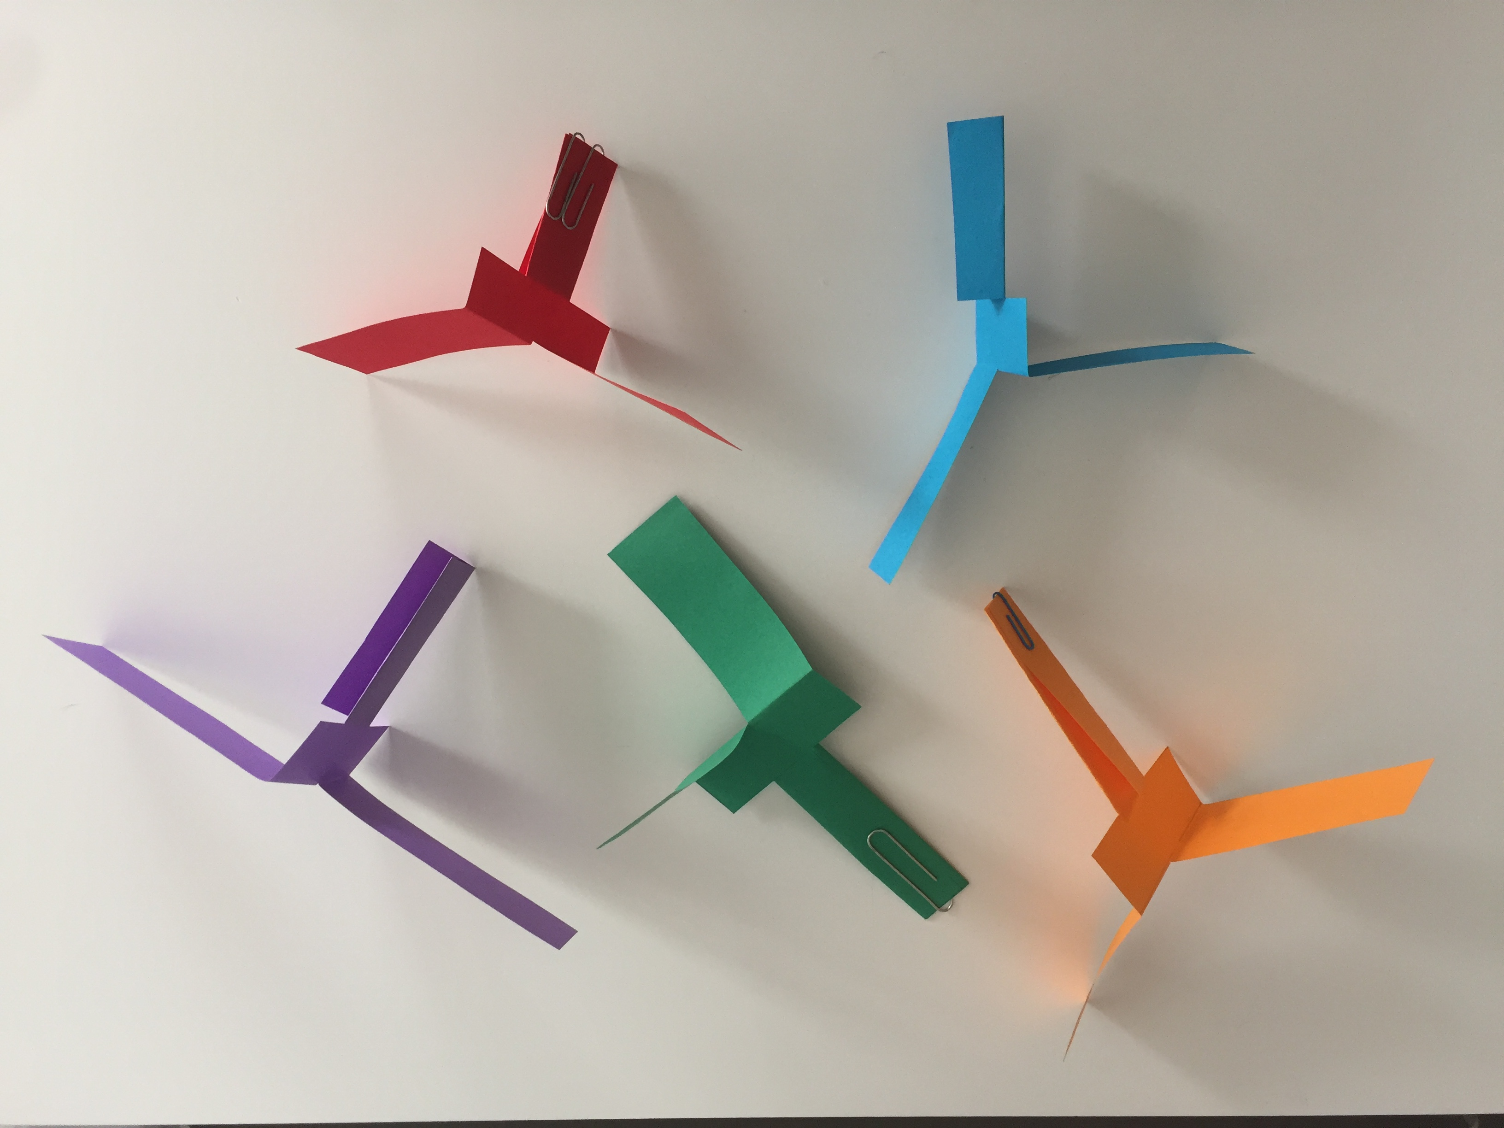
Paper spinners
What do I need?
Paper, pencil, scissors, paper clips or staples, timer
What do I do?
Trace our template (see page 5) on a piece of paper.
Cut along the solid lines and fold along the dotted lines to make the
spinner as shown in the diagram on page 5.
Add a paper clip or staples to the bottom of the spinner for extra weight.
Hold your spinner up in the air, drop it and watch it spin!
What could I change?
Now think about all the things that could be changed if you did this activity again. Perhaps you could try a different number of paper clips, a different type of paper, a different design with longer ‘rotor blades’, a bigger or smaller spinner, dropping it from a different height or outside instead of inside…

Slide 4
What could I measure?
Now think about what you could measure if you did this activity again. How long the spinner takes to fall? The height that you drop the spinner from? How many times the spinner rotates as it falls? How much the spinner weighs? Or even the shape of the spinner’s flightpath when thrown or caught by the breeze?
What could I investigate?
Based on your thinking about what could be changed and what could be measured, decide on your own investigation question. It could be, ‘How does the type of paper affect the speed a spinner falls?’ or ‘Does a spinner rotate more times if it is dropped from a greater height?’ Make your own prediction about what will happen and why you think that before you start.
Time to investigate!
Complete the experiments that you need to do in order to answer your investigation question. Remember that to carry out a ‘fair test’, you should only change one thing at a time, keeping everything else the same. You may need to carry out experiments more than once to improve the accuracy of your results. Think about how to record what happened – perhaps using a table of results showing your measurements, or take photos or videos. Was your prediction correct?
Register your school to take part in the Big Science Event on our website

Slide 5
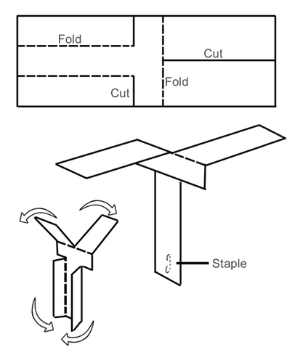
Paper spinner template

Slide 6
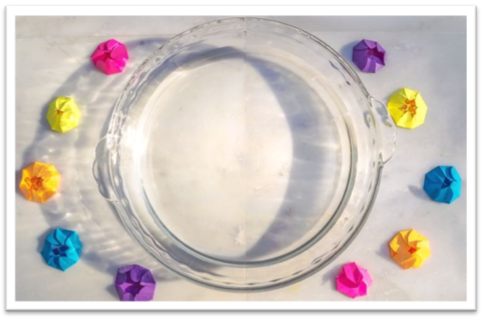
Paper flowers
What do I need?
Paper (you may want different types), scissors, pen/pencil, a watertight
tray or bowl, water, timer
What do I do?
Draw a simple flower shape with several petals on a piece of paper.
You might want to use our template on page 8.
Cut out your flower.
Fold the petals of your flower one by one into the centre.
Add some water to your tray or bowl – you only need a shallow depth to cover the base.
Carefully place the flower, with its petals uppermost, onto the surface.
Watch what happens – it may take a couple of minutes!
What could I change?
Now think about all the things that could be changed if you did this activity again. Perhaps you could change the type of paper, the size of the flower or the number of petals, how you fold flower or even something to do with the water that the flower is floating on.

Slide 7
What could I measure?
Now think about what you could measure if you did this activity again. How long it takes the flower to open? How big the flower is? How many petals the flower has? Or even the temperature of the water?
What could I investigate?
Based on your thinking about what could be changed and what could be measured, decide on your own investigation question. It could be, ‘How does the temperature of the water affect the speed of the petals opening?’ or, ‘Does a small flower open more quickly than a big flower?’ Make your own prediction about what will happen and why you think that before you start.
Time to investigate!
Complete the experiments that you need to do in order to answer your investigation question. Remember that to carry out a ‘fair test’, you should only change one thing at a time, keeping everything else the same. You may need to carry out experiments more than once to improve the accuracy of your results. Think about how to record what happened – perhaps using a table of results showing your measurements, or take photos or videos. Was your prediction correct?
Register your school to take part in the Big Science Event on our website

Slide 8
Flower template

Slide 9
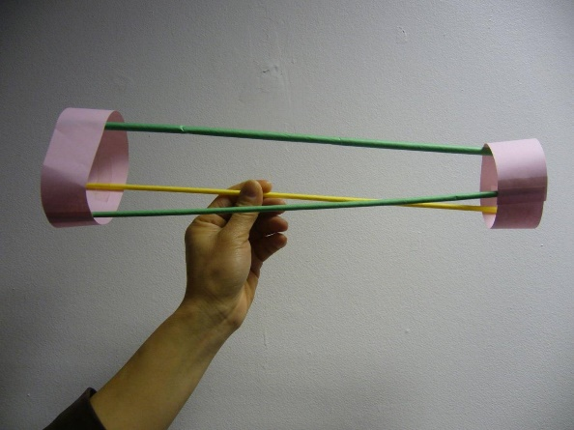
Hoop flyers
What do I need?
Card or paper, pencil, ruler, scissors, drinking straws, sticky tape, paper clips
(optional)
What do I do?
Cut out two strips of card or paper, both about the width of a ruler
(about 4cm). Make one strip slightly longer than the other. If you
use a piece of A4 card or paper, we suggest cutting the strips as
shown on page 11.
Curl these strips around into a loop and fasten with tape so that you have two hoops of card or paper, one smaller than the other.
Join the two hoops together using three straws spaced equally around the hoops and fix together as image on page 11.
Hold the Hoop Flyer in the middle of the straw, with the little hoop in front. Throw it like a spear. It will take a few practice throws to get the hang of it!

Slide 10
What could I change?
Now think about all the things that could be changed if you did this activity again. Perhaps you could change the type of paper/card, the size of the hoops, the number or length of the straws or even add some weight to the flyer using paperclips.
What could I measure?
Now think about what you could measure if you did this activity again. How long it takes your flyer to fall to the ground? How far it travels or whether it can hit a target?
What could I investigate?
Based on your thinking about what could be changed and what could be measured, decide on your own investigation question. It could be, ‘How does the width of hoops affect the length of flight?’ or, ‘What is the greatest number of paper clips a flyer can carry across 5 metres?’ Make your own prediction about what will happen and why you think that before you start.
Time to investigate!
Complete the experiments that you need to do in order to answer your investigation question. Remember that to carry out a ‘fair test’, you should only change one thing at a time, keeping everything else the same. You may need to carry out experiments more than once to improve the accuracy of your results. Think about how to record what happened – perhaps using a table of results showing your measurements, or take photos or videos. Was your prediction correct?
Register your school to take part in the Big Science Event on our website

Slide 11
Hoop flyers templates
Strip 1
Strip 2

Slide 12
Enter the Big Science Event
Register your school via our website
scienceoxford.com/big-science-event-at-school
Follow us on social media.
@scienceoxford #bigscienceevent
If you have any questions, just email us on:
competition@scienceoxford.com
scienceoxford.com

