Slide 1
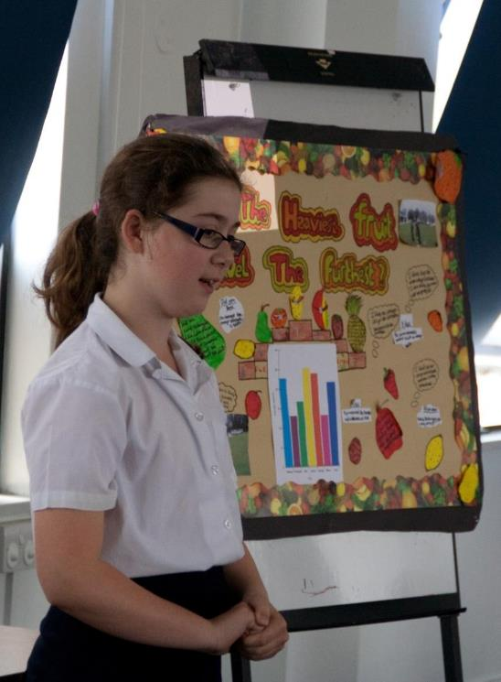

Notes:
What the Big Science Event is – a primary school competition designed to encourage PUPIL-LED, creative science investigations
Originally run by the Primary Science consultant for Oxfordshire in response to their need for support and inspiration for Science Enquiry
Currently run in Oxfordshire and Buckinghamshire schools with support from Abbott Diabetes Care and Playforce – who provide a school prize, support marketing costs, and give 3 days of staff time for judging.

Slide 2
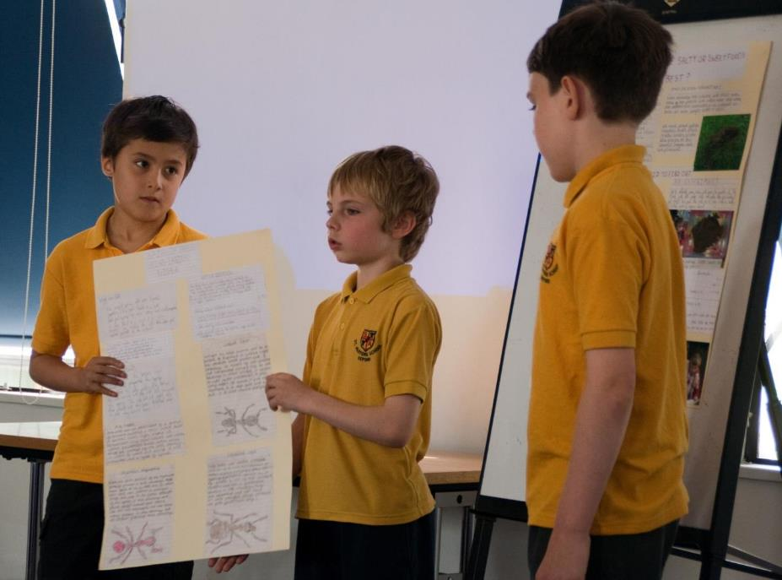
Notes:
The competition is open to all schools and year groups.
Children work in small groups of up to 5 pupils to carry out their investigations, create a poster and present their findings
Schools carry out their own in school judging to select a KS1 and KS 2 team to go through to the cluster judging stage
Cluster judging is carried out by Science Oxford staff and volunteers
10-12 teams are selected to go through to the finals day
All admin is carried out via the Science Oxford website including registration, uploading of selected teams and details of the final day. Contact teachers will also be sent regular email updates and reminders

Slide 3
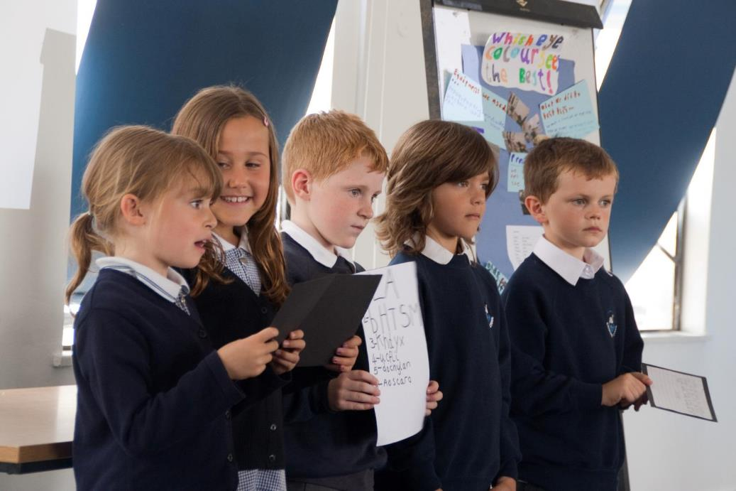
Notes:
‘Finals Day’ involves teams giving a 5 minute presentation about their investigation to a panel of judges as well as enjoying a science workshop and show. In Bucks the final is incorporated into the Big Bang @ Bucks
Pupils from both KS1 and KS2 participate in the competition and there is usually at least 1 KS1 team that makes it to the final
This is a group of Year 2 pupils presenting at ‘Finals Day’ in 2012 with “Which Eye Colour Sees the Best?”
All finalists receive a goodie bag, Top 3 teams receive individual prizes and the overall winning school receives the Playforce prize of £1200 worth of playground equipment

Slide 4
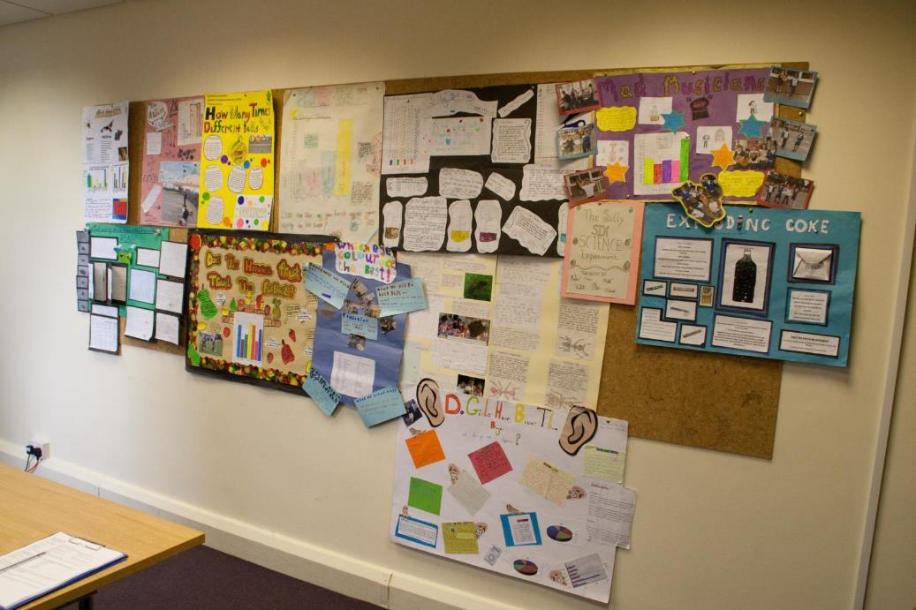
Notes:
All participating teams are also required to create a poster about their investigation – these are used to support their presentations and are displayed on ‘Finals Day’

Slide 5
Do people brush the opposite sides of their mouth better? Which fruit is the most hard wearing after being dropped from a fire escape? When the string on a telephone is short is the sound louder? Which fizzy drink freezes quickest? Which material makes the best back for a vortex cannon? Is there a difference in the heart rate at different ages? Which colour gummy bear is the toughest? What form of un-electronic communication works best? Can you run faster swinging your arms? How much air does it take to pop a banana? Which colour eye sees the best? Does the size of your hands affect your ability to tie laces? What sort of stone makes the biggest splash? Do ants like salty or sweet foods best? What’s the best biscuit to dunk into a cup of tea? What material would make the best parachute for Batman? How many times do different balls bounce? What do animals make you feel? Do girls hear better than boys? What is the best material to muffle a sound?
Notes:
Examples of pupil-led investigation questions that have been part of the Big Science Event
Fantastic, creative questions that adults would often never think of and which really motivate pupils to do their best work

Slide 6
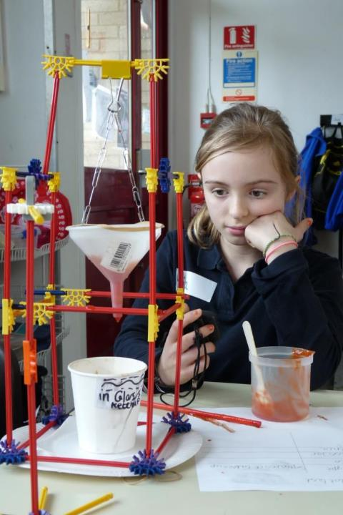
Oxford Brookes research with 16 primary schools in 2002-04 and the subsequent TDTS project has found that the following approaches lead to increased engagement & achievement:
  More questioning
  Deeper thinking
  More discussion
  Less writing
  More practical activity
Notes:
WHY IS A PROJECT LIKE THE BIG SCIENCE EVENT IMPORTANT?
The competition encourages all of these things to happen in primary science lessons. Any writing is focussed and with a clear purpose.

Slide 7
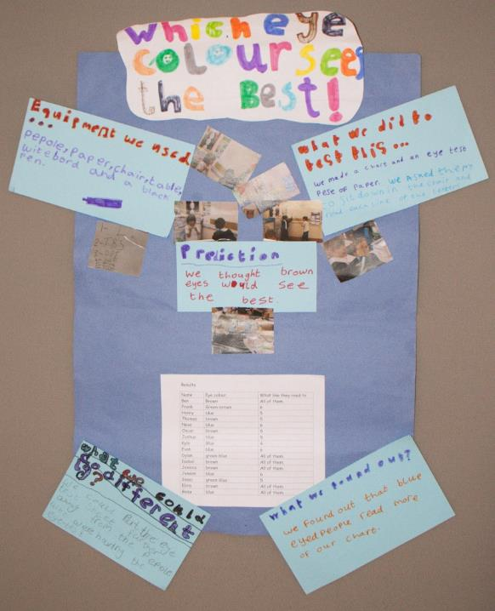
“I didn’t really enjoy science before. I like to choose what we do, it’s more fun. Usually we are set an investigation and have to follow instructions. Now we can enjoy the mystery of not knowing what will happen.” Year 6 Pupil
“I liked being able to choose an experiment. I enjoyed it more – we had more control over what we were doing.” Year 5 Pupil
“The best bit was doing something that other people wouldn’t have thought of.” Year 4 Pupil
Notes:
WHY IS A PROJECT LIKE THE BIG SCIENCE EVENT IMPORTANT?
Well listen to what pupils and teachers have to say about the Big Science Event and the impact it has had on them.
Teacher quotes were from evaluation forms that they completed for us and pupil quotes were collected verbally during short interviews.
Pupils LOVE having more input/control over what they do in science, it makes a big difference to them.

Slide 8
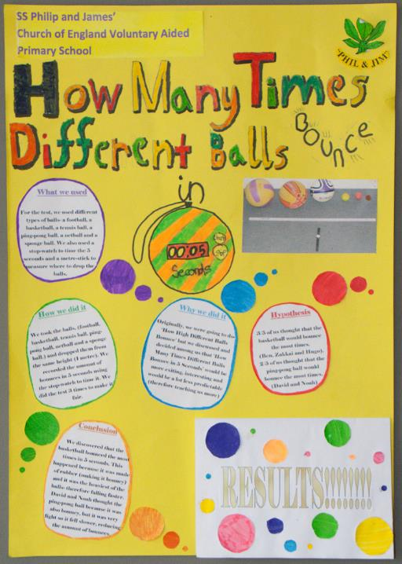
“The Big Science Event has provided a competitive purpose and context which the majority of pupils rise to. I can therefore see everything we, as a school, teach in science being used and practiced by the pupils.” Teacher
“Coordinating the Big Science Event in school has allowed me to get to know children across a wider age range, which has increased children’s interest in after-school science club.” Teacher
“We are now doing a ‘Big Science Event’ style experiment three times a year.” Teacher
Notes:
WHY IS IT IMPORTANT?
Provides teachers with a showcase for their pupils skills and learning in science.
Provides teachers with an opportunity to get to know more pupils and to raise the profile of science in their school.
Encourages them to give something valuable a go that they wouldn’t have done otherwise.
Clear evidence of working scientifically

Slide 9
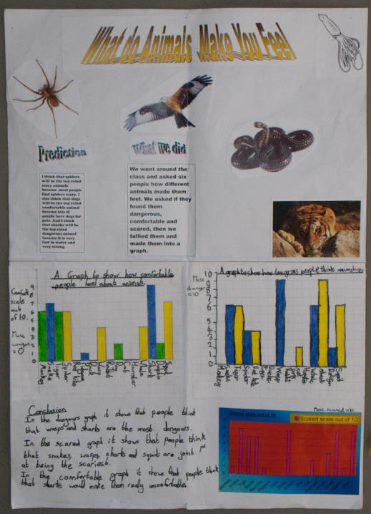
“The best bit was learning how to work together. We got on really well and we don’t have to be best friends to work well together. We found out that we were all good at different things.” Year 6 Pupil
“In science normally we’d all be doing the same experiment, with different ones you learn more from other people.” Year 4 Pupil
“I’m getting better at learning, even how to spell new words. Words like hypothesis and participant and accurate. I feel like I’ve learnt a new language of science!” Year 5 Pupil
Notes:
WHY IS IT IMPORTANT?
Competition provides a opportunity for learning across different curriculum areas – personal learning and thinking skills (e.g. team working, problem solving, communication), science enquiry skills, literacy (oracy skills, new vocabulary) and numeracy (display and interpretation of data)

Slide 10
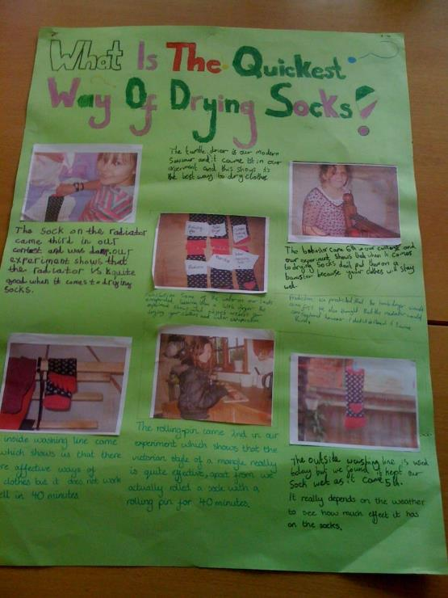
“The school uses projects like this to improve literacy and numeracy as well as to develop science enquiry skills.” Head Teacher
“It’s a great opportunity to use and apply maths in a science context.” Teacher
“It was nice to see children taking their existing knowledge and applying it. They were able to take the experiment all the way through from choosing at the beginning to thihking about extensions.” Teacher
“It was good to get the whole school talking about science and to see even our very smallest children choosing what to investigate.” Teacher
Notes:
WHY IS IT IMPORTANT?
Teachers see the cross curricular opportunities provided by the competition as well as the chance for children to use and apply their skills in contexts chosen by them. It’s also a way of raising the profile of science across the school.

Slide 11
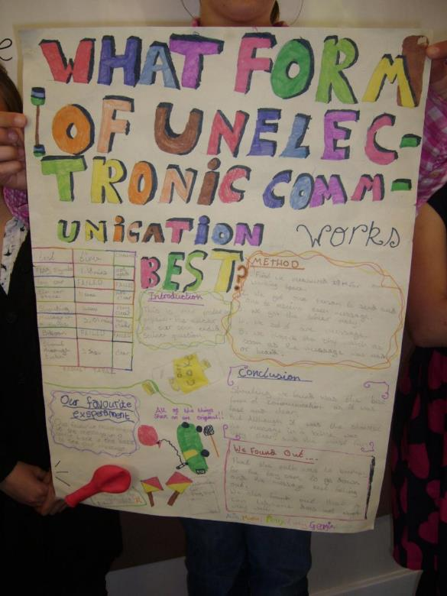
“Before the competition I thought science was boring and confusing. Now I think it’s enjoyable and interesting. Science is about experiments and finding things out.” Year 6 Pupil
“I feel like we do more experiments now. Now we feel more excited when we know we are going to do science.” Year 5 Pupil
“I thought science was about answering questions and remembering stuff and I didn’t feel good at it. Now I know it’s about having fun and discovering new stuff …” Year 5 Pupil
Notes:
WHY IS IT IMPORTANT?
Feedback from pupils also shows how taking part in the competition can change how they perceive science and how they feel about it.

Slide 12
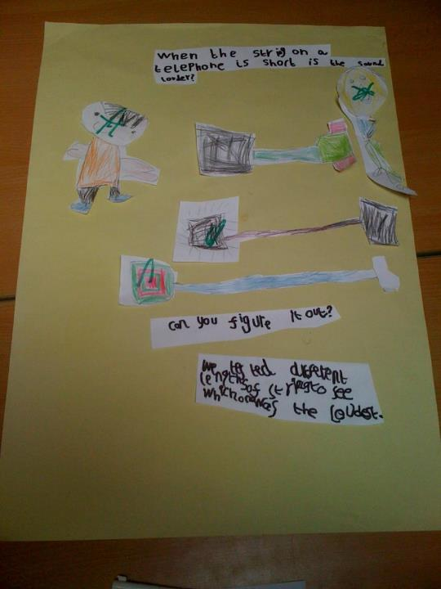
“I now understand just how much children like to choose what they will investigate. We will give them the freedom to do this more often.” Teacher
“It was great to see the children take the lead in asking questions and finding the answers through experimenting with things. I should give them more opportunities to learn this way.” Teacher
“I feel more confident about talking to the rest of the staff now about conducting experiments and sharing the ideas at a staff meeting.” Teacher
Notes:
WHY IS IT IMPORTANT?
It enables teachers to see what engages pupils in science and what they are capable of if you give them a bit more ownership, as well as increasing teachers’ confidence in their own ability to lead and manage more open ended science investigations.

Slide 13
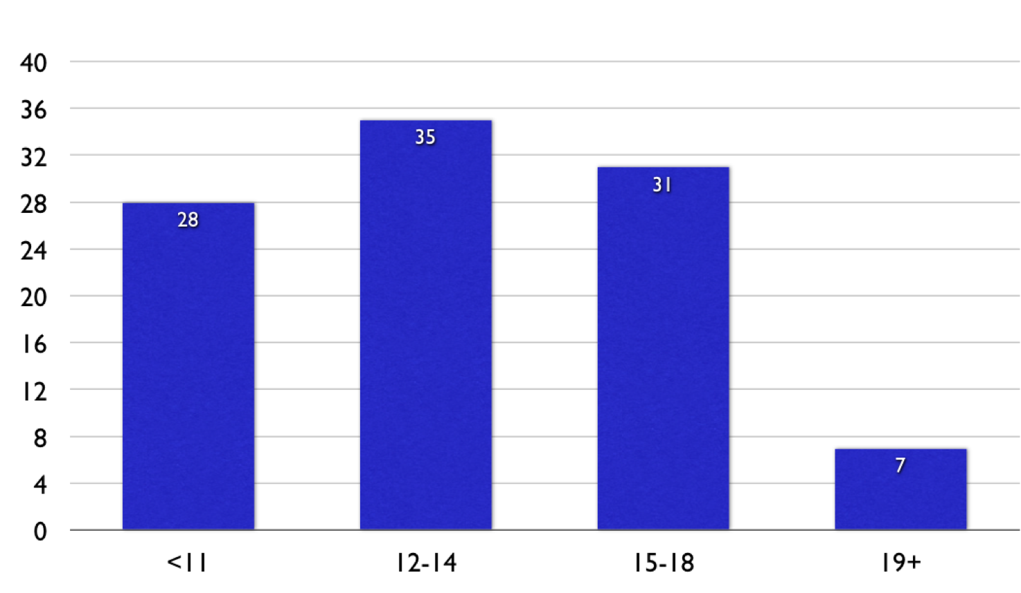
Age When Scientists First Started Thinking of Working in STEM (n=1140)
%
Age
Notes:
WHY IS IT IMPORTANT?
Jonathan Osbourne slide from 2010
Research indicates that future scientists are inspired earlier rather than later.

Slide 14
“Over 85% of the Year 7 pupils felt they knew the job they wanted to do in the future and 65% of these pupils had held these views for over two years.”
How Young People Formulate Their Views About the Future
University of Westminster, 2009
Commissioned by DCSF
Focus groups with 610 pupils from 27 schools
Notes:
WHY IS IT IMPORTANT?
Research indicates that self-identity is formed earlier rather than later. So if you want pupils to perceive themselves as liking science, being good science, being capable of enjoying and doing a job well that relates to science etc then it’s maybe more important to focus on children of primary school age. There is currently more focus from funders/employers generally on KS3/4, but let’s not forget primary schools, especially now when the new primary science curriculum proposals seem to indicate much more focus on content (remembering facts) and less on skills and the process of doing science.

Slide 15
Timeline
Sept-Jan: Registrations (online)
Jan-Mar: Pupils carry out investigations and create posters
Mar-Apr: In-school judging, school selects winners
Easter: Schools upload selected KS1 and KS2 teams
May: Cluster judging by staff & volunteers
June/July: Event final at Science Oxford
Notes:
Current timeline followed by Science Oxford for the Big Science Event competition. Schools always asked to choose their own winners first. This work could be linked more strongly to the Primary Science Quality Mark.

